Slide 1
Design for Testability
CSE 244A
Monday November 18, 2019

Slide 2
Outline
What is Design-for-Test?
Scan Flop
Scan Chain
Applying Tests through Scan Chains
Cost of Scan Testing
Partial Scan

Slide 3
What is Design-for-Test?
Up to now, we’ve been looking at how to effectively test existing designs…
But what if we could alter/enhance our design to improve the testability of our designs?
  Testability:
    Controllability – how well can we drive stimulus to design
    Observability – how well can we observe the effects of that stimulus
Design-for-Test is designed to improve testability to either:
  Enhance coverage
  Reduce test cost

Slide 4
Scan Flip Flop – Base Element of DFT
Scan Flip Flops (SFF) give alternate non-functional method for loading data into Flip Flop
Functional Flip Flops can be converted to Scan Flip Flop by adding a Scan MUX
Two new input signals:
  TC – Test Control
    TC = 0: Scan Mode
    TC = 1: Functional Mode
  SCANIN – Scan Input is alternate input for loading data
SCANIN
0
D
Q
1
D
Q
SEL
TC
CLK
CLK

Slide 5
Scan Chains linking Scan Cells
COMB LOGIC
D
Q
COMB LOGIC
D
Q
COMB LOGIC
D
Q
COMB LOGIC
Primary Inputs
D
Q
D
Q
D
Q
Primary Outputs
D
Q
D
Q
D
Q
CLOCK

Slide 6
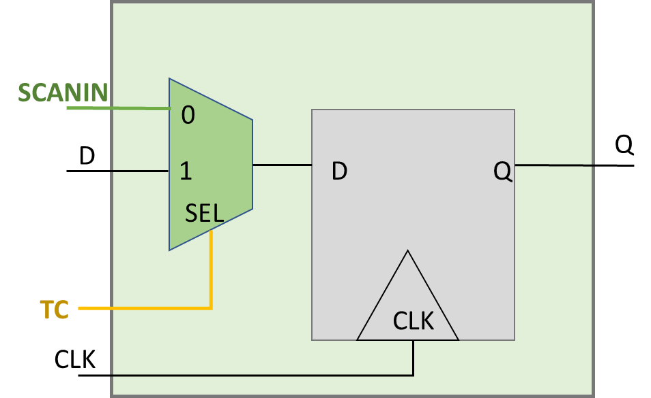
Scan Chains linking Scan Cells
COMB LOGIC
COMB LOGIC
COMB LOGIC
D
Q
COMB LOGIC
D
Q
D
Q
Primary Inputs
D
Q
D
Q
Primary Outputs
D
Q
D
Q
D
Q
D
Q
CLOCK

Slide 7
Scan Chains linking Scan Cells
TC
COMB LOGIC
COMB LOGIC
COMB LOGIC
D
Q
COMB LOGIC
D
Q
D
Q
Primary Inputs
D
Q
D
Q
Primary Outputs
D
Q
D
Q
D
Q
D
Q
CLOCK

Slide 8
Scan Chains linking Scan Cells
SCANIN
COMB LOGIC
COMB LOGIC
COMB LOGIC
D
Q
COMB LOGIC
D
Q
D
Q
Primary Inputs
D
Q
D
Q
Primary Outputs
D
Q
D
Q
D
Q
D
Q
CLOCK
SCANOUT

Slide 9
Scan Chains linking Scan Cells
SCANIN
TC
COMB LOGIC
COMB LOGIC
COMB LOGIC
D
Q
COMB LOGIC
D
Q
D
Q
Primary Inputs
D
Q
D
Q
Primary Outputs
D
Q
D
Q
D
Q
D
Q
CLOCK
SCANOUT

Slide 10
Scan Chains linking Scan Cells
SFF
SCANIN
TC
SFF
COMB LOGIC
SFF
COMB LOGIC
SFF
COMB LOGIC
COMB LOGIC
SFF
SFF
Primary Inputs
SFF
Primary Outputs
SFF
SFF
SFF
CLOCK
SCANOUT
Scan Flops+Scan Chains can turn Sequential Test into Combination Test

Slide 11
Applying Tests through Scan Chains
SFF
SCANIN
TC
SFF
COMB LOGIC
SFF
COMB LOGIC
SFF
COMB LOGIC
COMB LOGIC
SFF
SFF
Primary Inputs
SFF
Primary Outputs
SFF
SFF
SFF
CLOCK
SCANOUT
Cycle
SCANIN
SCANOUT
TC
CLOCK

Slide 12
Applying Tests through Scan Chains
SFF
Pattern 1, Step 1: Enable Test Mode, Scan Chains Load Test Stimulus
SCANIN
TC
SFF
COMB LOGIC
SFF
COMB LOGIC
SFF
COMB LOGIC
COMB LOGIC
A1
SFF
SFF
Primary Inputs
SFF
Primary Outputs
SFF
SFF
SFF
CLOCK
SCANOUT
Shift (Load Pattern 1)
Cycle
SCANIN
SCANOUT
TC
CLOCK
1
A1
X
0
P

Slide 13
Applying Tests through Scan Chains
SFF
Pattern 1, Step 1: Enable Test Mode, Scan Chains Load Test Stimulus
SCANIN
TC
SFF
COMB LOGIC
SFF
COMB LOGIC
SFF
COMB LOGIC
COMB LOGIC
B1
SFF
SFF
Primary Inputs
SFF
Primary Outputs
A1
SFF
SFF
SFF
CLOCK
SCANOUT
Shift (Load Pattern 1)
Cycle
SCANIN
SCANOUT
TC
CLOCK
1 2
A1 B1
X X
0 0
P P

Slide 14
Applying Tests through Scan Chains
SFF
Pattern 1, Step 1: Enable Test Mode, Scan Chains Load Test Stimulus
SCANIN
TC
SFF
COMB LOGIC
SFF
COMB LOGIC
SFF
COMB LOGIC
COMB LOGIC
C1
SFF
SFF
Primary Inputs
SFF
Primary Outputs
B1
SFF
SFF
SFF
A1
CLOCK
SCANOUT
Shift (Load Pattern 1)
Cycle
SCANIN
SCANOUT
TC
CLOCK
1 2 3
A1 B1 C1
X X X
0 0 0
P P P

Slide 15
Applying Tests through Scan Chains
SFF
Pattern 1, Step 1: Enable Test Mode, Scan Chains Load Test Stimulus
SCANIN
TC
SFF
COMB LOGIC
SFF
COMB LOGIC
SFF
COMB LOGIC
COMB LOGIC
D1
SFF
SFF
Primary Inputs
SFF
Primary Outputs
C1
SFF
SFF
SFF
B1
A1
CLOCK
SCANOUT
Shift (Load Pattern 1)
Cycle
SCANIN
SCANOUT
TC
CLOCK
1 2 3 4
A1 B1 C1 D1
X X X X
0 0 0 0
P P P P

Slide 16
Applying Tests through Scan Chains
SFF
Pattern 1, Step 1: Enable Test Mode, Scan Chains Load Test Stimulus
SCANIN
TC
SFF
COMB LOGIC
SFF
COMB LOGIC
SFF
COMB LOGIC
COMB LOGIC
E1
SFF
SFF
Primary Inputs
SFF
Primary Outputs
D1
A1
SFF
SFF
SFF
C1
B1
CLOCK
SCANOUT
Shift (Load Pattern 1)
Cycle
SCANIN
SCANOUT
TC
CLOCK
1 2 3 4 5
A1 B1 C1 D1 E1
X X X X X
0 0 0 0 0
P P P P P

Slide 17
Applying Tests through Scan Chains
SFF
Pattern 1, Step 1: Enable Test Mode, Scan Chains Load Test Stimulus
SCANIN
TC
SFF
COMB LOGIC
SFF
COMB LOGIC
SFF
COMB LOGIC
COMB LOGIC
F1
A1
SFF
SFF
Primary Inputs
SFF
Primary Outputs
E1
B1
SFF
SFF
SFF
D1
C1
CLOCK
SCANOUT
Shift (Load Pattern 1)
Cycle
SCANIN
SCANOUT
TC
CLOCK
1 2 3 4 5 6
A1 B1 C1 D1 E1 F1
X X X X X X
0 0 0 0 0 0
P P P P P P

Slide 18
Applying Tests through Scan Chains
SFF
Pattern 1, Step 1: Enable Test Mode, Scan Chains Load Test Stimulus
SCANIN
TC
SFF
COMB LOGIC
SFF
COMB LOGIC
SFF
COMB LOGIC
COMB LOGIC
G1
A1
B1
SFF
SFF
Primary Inputs
SFF
Primary Outputs
F1
C1
SFF
SFF
SFF
E1
D1
CLOCK
SCANOUT
Shift (Load Pattern 1)
Cycle
SCANIN
SCANOUT
TC
CLOCK
1 2 3 4 5 6 7
A1 B1 C1 D1 E1 F1 G1
X X X X X X X
0 0 0 0 0 0 0
P P P P P P P

Slide 19
Applying Tests through Scan Chains
SFF
Pattern 1, Step 1: Enable Test Mode, Scan Chains Load Test Stimulus
SCANIN
TC
SFF
COMB LOGIC
SFF
COMB LOGIC
SFF
COMB LOGIC
COMB LOGIC
B1
H1
C1
SFF
SFF
Primary Inputs
SFF
A1
Primary Outputs
G1
D1
SFF
SFF
SFF
F1
E1
CLOCK
SCANOUT
Shift (Load Pattern 1)
Cycle
SCANIN
SCANOUT
TC
CLOCK
1 2 3 4 5 6 7 8
A1 B1 C1 D1 E1 F1 G1 H1
X X X X X X X X
0 0 0 0 0 0 0 0
P P P P P P P P

Slide 20
Applying Tests through Scan Chains
SFF
Pattern 1, Step 1: Enable Test Mode, Scan Chains Load Test Stimulus
SCANIN
TC
SFF
COMB LOGIC
SFF
COMB LOGIC
SFF
COMB LOGIC
COMB LOGIC
C1
I1
D1
SFF
SFF
Primary Inputs
SFF
B1
Primary Outputs
H1
E1
SFF
SFF
SFF
A1
G1
F1
CLOCK
SCANOUT
Shift (Load Pattern 1)
Cycle
SCANIN
SCANOUT
TC
CLOCK
1 2 3 4 5 6 7 8 9
A1 B1 C1 D1 E1 F1 G1 H1 I1
X X X X X X X X X
0 0 0 0 0 0 0 0 0
P P P P P P P P P

Slide 21
Applying Tests through Scan Chains
SFF
Pattern 1, Step 2: Change to Functional Mode, Capture from Comb Logic
SCANIN
TC
SFF
COMB LOGIC
SFF
COMB LOGIC
SFF
COMB LOGIC
COMB LOGIC
S1
Z1
T1
SFF
SFF
Primary Inputs
SFF
R1
Primary Outputs
Y1
U1
SFF
SFF
SFF
Q1
W1
V1
CLOCK
SCANOUT
Shift (Load Pattern 1)
Capture (P1)
Cycle
SCANIN
SCANOUT
TC
CLOCK
1 2 3 4 5 6 7 8 9
10
A1 B1 C1 D1 E1 F1 G1 H1 I1
-
X X X X X X X X X
X
0 0 0 0 0 0 0 0 0
1
P P P P P P P P P
P

Slide 22
Applying Tests through Scan Chains
SFF
Pattern 1, Step 3: Enable Test Mode, Scan Chains Unload Captured Data
Pattern 2, Step 1: Scan Chains Load Test Stimulus
SCANIN
TC
SFF
COMB LOGIC
SFF
COMB LOGIC
SFF
COMB LOGIC
COMB LOGIC
A2
U1
T1
SFF
SFF
Primary Inputs
SFF
S1
Primary Outputs
Z1
V1
SFF
SFF
SFF
R1
Y1
W1
CLOCK
SCANOUT
Shift (Load Pattern 1)
Capture (P1)
Shift (Unload Pattern 1, Load Pattern 2)
Cycle
SCANIN
SCANOUT
TC
CLOCK
1 2 3 4 5 6 7 8 9
10
11
A1 B1 C1 D1 E1 F1 G1 H1 I1
-
A2
X X X X X X X X X
X
Q1
0 0 0 0 0 0 0 0 0
1
0
P P P P P P P P P
P
P

Slide 23
Applying Tests through Scan Chains
SFF
Pattern 1, Step 3: Enable Test Mode, Scan Chains Unload Captured Data
Pattern 2, Step 1: Scan Chains Load Test Stimulus
SCANIN
TC
SFF
COMB LOGIC
SFF
COMB LOGIC
SFF
COMB LOGIC
COMB LOGIC
B2
V1
U1
SFF
SFF
Primary Inputs
SFF
T1
Primary Outputs
A2
W1
SFF
SFF
SFF
S1
Z1
Y1
CLOCK
SCANOUT
Shift (Load Pattern 1)
Capture (P1)
Shift (Unload Pattern 1, Load Pattern 2)
Cycle
SCANIN
SCANOUT
TC
CLOCK
1 2 3 4 5 6 7 8 9
10
11 12
A1 B1 C1 D1 E1 F1 G1 H1 I1
-
A2 B2
X X X X X X X X X
X
Q1 R1
0 0 0 0 0 0 0 0 0
1
0 0
P P P P P P P P P
P
P P

Slide 24
Applying Tests through Scan Chains
SFF
Pattern 1, Step 3: Enable Test Mode, Scan Chains Unload Captured Data
Pattern 2, Step 1: Scan Chains Load Test Stimulus
SCANIN
TC
SFF
COMB LOGIC
SFF
COMB LOGIC
SFF
COMB LOGIC
COMB LOGIC
V1
C2
W1
SFF
SFF
Primary Inputs
SFF
U1
Primary Outputs
B2
Y1
SFF
SFF
SFF
T1
A2
Z1
CLOCK
SCANOUT
Shift (Load Pattern 1)
Capture (P1)
Shift (Unload Pattern 1, Load Pattern 2)
Cycle
SCANIN
SCANOUT
TC
CLOCK
1 2 3 4 5 6 7 8 9
10
11 12 13
A1 B1 C1 D1 E1 F1 G1 H1 I1
-
A2 B2 C2
X X X X X X X X X
X
Q1 R1 S1
0 0 0 0 0 0 0 0 0
1
0 0 0
P P P P P P P P P
P
P P P

Slide 25
Applying Tests through Scan Chains
SFF
Pattern 1, Step 3: Enable Test Mode, Scan Chains Unload Captured Data
Pattern 2, Step 1: Scan Chains Load Test Stimulus
SCANIN
TC
SFF
COMB LOGIC
SFF
COMB LOGIC
SFF
COMB LOGIC
COMB LOGIC
D2
W1
Y1
SFF
SFF
Primary Inputs
SFF
V1
Primary Outputs
C2
Z1
SFF
SFF
SFF
A2
U1
B2
CLOCK
SCANOUT
Shift (Load Pattern 1)
Capture (P1)
Shift (Unload Pattern 1, Load Pattern 2)
Cycle
SCANIN
SCANOUT
TC
CLOCK
1 2 3 4 5 6 7 8 9
10
11 12 13 14
A1 B1 C1 D1 E1 F1 G1 H1 I1
-
A2 B2 C2 D2
X X X X X X X X X
X
Q1 R1 S1 T1
0 0 0 0 0 0 0 0 0
1
0 0 0 0
P P P P P P P P P
P
P P P P

Slide 26
Applying Tests through Scan Chains
SFF
Pattern 1, Step 3: Enable Test Mode, Scan Chains Unload Captured Data
Pattern 2, Step 1: Scan Chains Load Test Stimulus
SCANIN
TC
SFF
COMB LOGIC
SFF
COMB LOGIC
SFF
COMB LOGIC
COMB LOGIC
E2
Z1
Y1
SFF
SFF
Primary Inputs
SFF
W1
Primary Outputs
D2
A2
SFF
SFF
SFF
V1
C2
B2
CLOCK
SCANOUT
Shift (Load Pattern 1)
Capture (P1)
Shift (Unload Pattern 1, Load Pattern 2)
Cycle
SCANIN
SCANOUT
TC
CLOCK
1 2 3 4 5 6 7 8 9
10
11 12 13 14 15
A1 B1 C1 D1 E1 F1 G1 H1 I1
-
A2 B2 C2 D2 E2
X X X X X X X X X
X
Q1 R1 S1 T1 U1
0 0 0 0 0 0 0 0 0
1
0 0 0 0 0
P P P P P P P P P
P
P P P P P

Slide 27
Applying Tests through Scan Chains
SFF
Pattern 1, Step 3: Enable Test Mode, Scan Chains Unload Captured Data
Pattern 2, Step 1: Scan Chains Load Test Stimulus
SCANIN
TC
SFF
COMB LOGIC
SFF
COMB LOGIC
SFF
COMB LOGIC
Z1
COMB LOGIC
F2
A2
SFF
SFF
Primary Inputs
SFF
Y1
Primary Outputs
E2
B2
SFF
SFF
SFF
W1
D2
C2
CLOCK
SCANOUT
Shift (Load Pattern 1)
Capture (P1)
Shift (Unload Pattern 1, Load Pattern 2)
Cycle
SCANIN
SCANOUT
TC
CLOCK
1 2 3 4 5 6 7 8 9
10
11 12 13 14 15 16
A1 B1 C1 D1 E1 F1 G1 H1 I1
-
A2 B2 C2 D2 E2 F2
X X X X X X X X X
X
Q1 R1 S1 T1 U1 V1
0 0 0 0 0 0 0 0 0
1
0 0 0 0 0 0
P P P P P P P P P
P
P P P P P P

Slide 28
Applying Tests through Scan Chains
SFF
Pattern 1, Step 3: Enable Test Mode, Scan Chains Unload Captured Data
Pattern 2, Step 1: Scan Chains Load Test Stimulus
SCANIN
TC
SFF
COMB LOGIC
SFF
COMB LOGIC
SFF
COMB LOGIC
COMB LOGIC
G2
B2
A2
SFF
SFF
Primary Inputs
SFF
Z1
Primary Outputs
F2
C2
SFF
SFF
SFF
Y1
E2
D2
CLOCK
SCANOUT
Shift (Load Pattern 1)
Capture (P1)
Shift (Unload Pattern 1, Load Pattern 2)
Cycle
SCANIN
SCANOUT
TC
CLOCK
1 2 3 4 5 6 7 8 9
10
11 12 13 14 15 16 17
A1 B1 C1 D1 E1 F1 G1 H1 I1
-
A2 B2 C2 D2 E2 F2 G2
X X X X X X X X X
X
Q1 R1 S1 T1 U1 V1 W1
0 0 0 0 0 0 0 0 0
1
0 0 0 0 0 0 0
P P P P P P P P P
P
P P P P P P P

Slide 29
Applying Tests through Scan Chains
SFF
Pattern 1, Step 3: Enable Test Mode, Scan Chains Unload Captured Data
Pattern 2, Step 1: Scan Chains Load Test Stimulus
SCANIN
TC
SFF
COMB LOGIC
SFF
COMB LOGIC
SFF
COMB LOGIC
B2
COMB LOGIC
H2
C2
SFF
SFF
Primary Inputs
SFF
A2
Primary Outputs
G2
D2
SFF
SFF
SFF
Z1
F2
E2
CLOCK
SCANOUT
Shift (Load Pattern 1)
Capture (P1)
Shift (Unload Pattern 1, Load Pattern 2)
Cycle
SCANIN
SCANOUT
TC
CLOCK
1 2 3 4 5 6 7 8 9
10
11 12 13 14 15 16 17 18
A1 B1 C1 D1 E1 F1 G1 H1 I1
-
A2 B2 C2 D2 E2 F2 G2 H2
X X X X X X X X X
X
Q1 R1 S1 T1 U1 V1 W1 Y1
0 0 0 0 0 0 0 0 0
1
0 0 0 0 0 0 0 0
P P P P P P P P P
P
P P P P P P P P

Slide 30
Applying Tests through Scan Chains
SFF
Pattern 1, Step 3: Enable Test Mode, Scan Chains Unload Captured Data
Pattern 2, Step 1: Scan Chains Load Test Stimulus
SCANIN
TC
SFF
COMB LOGIC
SFF
COMB LOGIC
SFF
COMB LOGIC
COMB LOGIC
C2
I2
D2
SFF
SFF
Primary Inputs
SFF
B2
Primary Outputs
H2
E2
SFF
SFF
SFF
A2
G2
F2
CLOCK
SCANOUT
Shift (Load Pattern 1)
Capture (P1)
Shift (Unload Pattern 1, Load Pattern 2)
Cycle
SCANIN
SCANOUT
TC
CLOCK
1 2 3 4 5 6 7 8 9
10
11 12 13 14 15 16 17 18 19
A1 B1 C1 D1 E1 F1 G1 H1 I1
-
A2 B2 C2 D2 E2 F2 G2 H2 I2
X X X X X X X X X
X
Q1 R1 S1 T1 U1 V1 W1 Y1 Z1
0 0 0 0 0 0 0 0 0
1
0 0 0 0 0 0 0 0 0
P P P P P P P P P
P
P P P P P P P P P

Slide 31
Applying Tests through Scan Chains
SFF
Pattern 2, Step 2: Change to Functional Mode, Capture from Comb Logic
SCANIN
TC
SFF
COMB LOGIC
SFF
COMB LOGIC
SFF
COMB LOGIC
COMB LOGIC
S2
Z2
T2
SFF
SFF
Primary Inputs
SFF
R2
Primary Outputs
Y2
U2
SFF
SFF
SFF
Q2
W2
V2
CLOCK
SCANOUT
Shift (Load Pattern 1)
Capture (P1)
Shift (Unload Pattern 1, Load Pattern 2)
Capture (P2)
Cycle
SCANIN
SCANOUT
TC
CLOCK
11 12 13 14 15 16 17 18 19
1 2 3 4 5 6 7 8 9
10
20
A1 B1 C1 D1 E1 F1 G1 H1 I1
-
A2 B2 C2 D2 E2 F2 G2 H2 I2
-
X X X X X X X X X
X
Q1 R1 S1 T1 U1 V1 W1 Y1 Z1
X
...
0 0 0 0 0 0 0 0 0
1
0 0 0 0 0 0 0 0 0
1
P P P P P P P P P
P
P P P P P P P P P
P

Slide 32

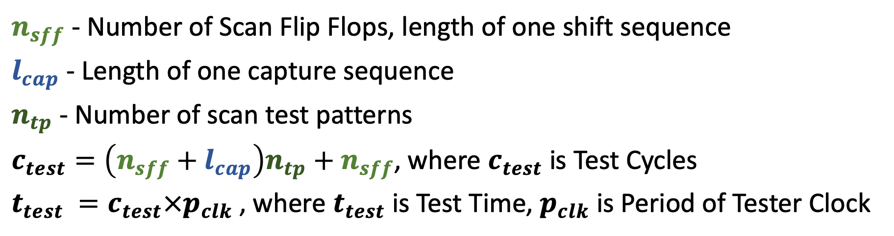

Test Cost for Scan Patterns
$n_{sff}$ - Number of Scan Flip Flops, length of one shift sequence
$l_{cap}$ - Length of one capture sequence
$n_{tp}$ - Number of scan test patterns
$c_{test}=\left(n_{sff}+l_{cap}\right)n_{tp}+n_{sff}$, where $c_{test}$ is Test Cycles
$t_{test} =c_{test}×p_{clk}$, where $t_{test}$is Test Time, $p_{clk}$ is Period of Tester Clock
$$n_{sff}$$
$$l_{cap}$$
Shift (Load Pattern 1)
Capture (P1)
Shift (Unload Pattern 1, Load Pattern 2)
Capture (P2)
Cycle
SCANIN
SCANOUT
TC
CLOCK
11 12 13 14 15 16 17 18 19
1 2 3 4 5 6 7 8 9
10
20
A1 B1 C1 D1 E1 F1 G1 H1 I1
-
A2 B2 C2 D2 E2 F2 G2 H2 I2
-
X X X X X X X X X
X
Q1 R1 S1 T1 U1 V1 W1 Y1 Z1
X
0 0 0 0 0 0 0 0 0
1
0 0 0 0 0 0 0 0 0
1
P P P P P P P P P
P
P P P P P P P P P
P

Slide 33
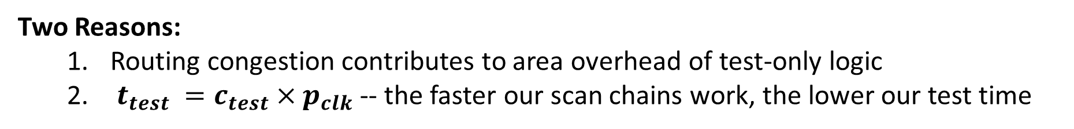
Scan Chain Stitching
Scan Chains configured based on SFF physical location
SCANIN
SCANIN
SFF
SFF
SFF
SFF
SFF
SFF
1
7
5
1
6
7
SFF
SFF
SFF
SFF
SFF
SFF
2
VS
6
9
2
5
8
SFF
SFF
SFF
SFF
SFF
SFF
3
4
8
3
4
9
SCANOUT
SCANOUT
Two Reasons:
Routing congestion contributes to area overhead of test-only logic
$t_{test} =c_{test}×p_{clk}$ -- the faster our scan chains work, the lower our test time

Slide 34
Cost of Design-for-Test
Design-for-Test can significantly reduce test time, but has other impacts on circuit
  Circuit area overhead of Scan MUX, Scan Chain routing, TC signal routing
  Performance impact of Scan MUXs on Functional Paths
  Potential yield impact of test-only failures
  Implementation effort
Design-for-Test logic consumes 5-10% of overall chip area for current industrial designs
Still, Quality/Cost benefits of improved Testability outweigh other (not insignificant) negative impacts of Design-for-Test

Slide 35
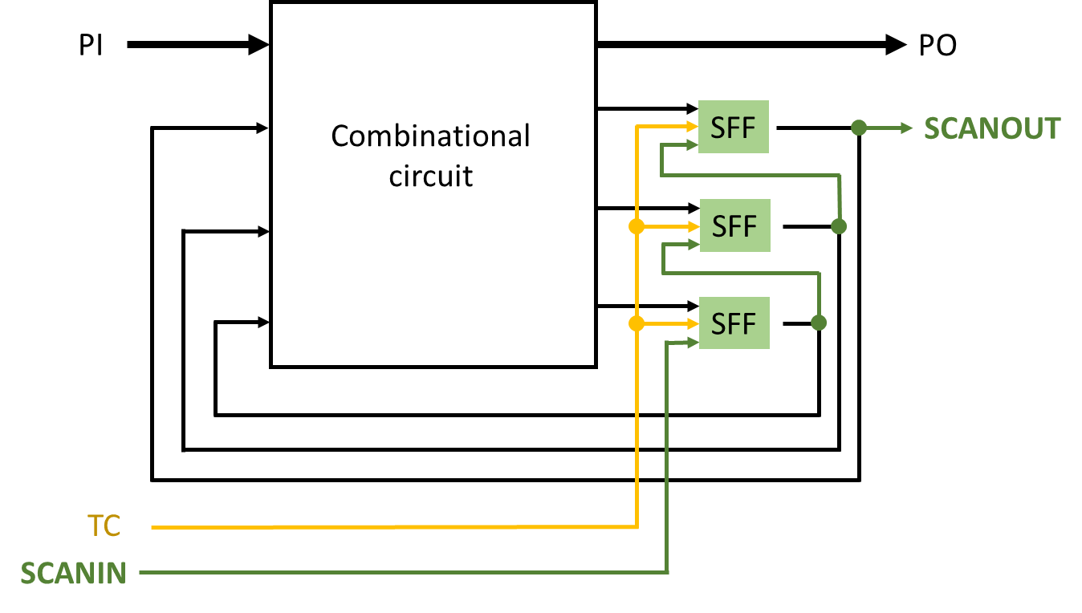
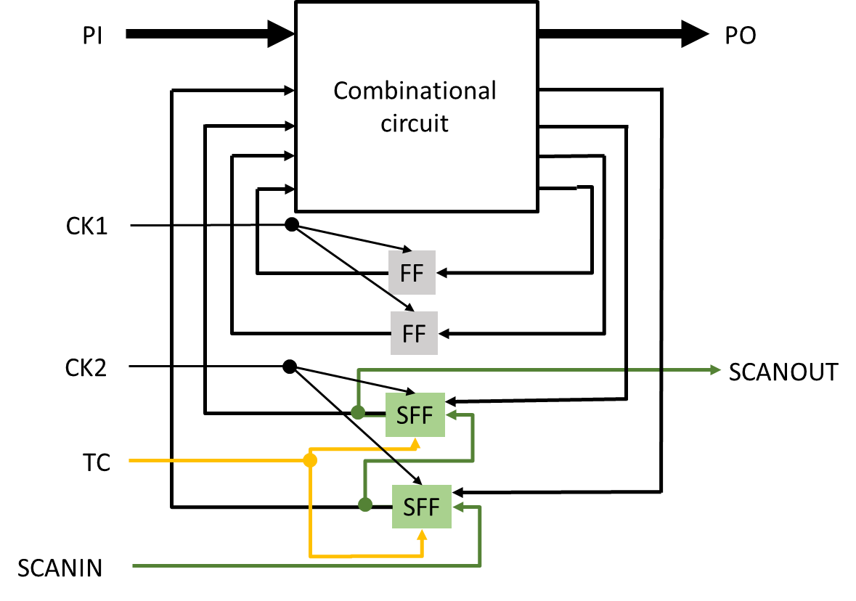
Alternate Technique – Partial Scan
Full Scan
Every functional flop becomes scan flop
Partial Scan
Strategically convert functional flops to scan flops
Clock not shown
(Only CK1 needed)
Partial scan gives opportunity to get benefits of scan while saving on circuit area

Slide 36
Cycle-Free Example
Circuit
F2
2
F3
F1
3
Level = 1
F2
2
s - graph
F1
F3
d_{seq} = 3
Level = 1
3
All faults are testable. See Example 8.6.

Slide 37
Relevant Results
Theorem 8.1: A cycle-free circuit is always initializable. It is also initializable in the presence of any non-flip-flop fault.
Theorem 8.2: Any non-flip-flop fault in a cycle-free circuit can be detected by at most d_{seq} + 1 vectors.
ATPG complexity: To determine that a fault is untestable in a cyclic circuit, an ATPG program using nine-valued logic may have to analyze 9^{Nff} time-frames, where Nff is the number of flip-flops in the circuit.

Slide 38
A Partial-Scan Method
Select a minimal set of flip-flops for scan to eliminate all cycles.
Alternatively, to keep the overhead low only long cycles may be eliminated.
In some circuits with a large number of self-loops, all cycles other than self-loops may be eliminated.

Slide 39
The MFVS Problem
For a directed graph find a set of vertices with smallest cardinality such that the deletion of this vertex-set makes the graph acyclic.
The minimum feedback vertex set (MFVS) problem is NP-complete; practical solutions use heuristics.
A secondary objective of minimizing the depth of acyclic graph is useful.
3
3
L=3
1
2
4
5
6
1
2
4
5
6
L=1
L=2
A 6-flip-flop circuit
s-graph

Slide 40
Partial vs. Full Scan: S5378
Original
2,781
179
0
0.0%
4,603
35/49
70.0%
70.9%
5,533 s
414
414
Partial-scan
2,781
149
30
2.63%
4,603
65/79
93.7%
99.5%
727 s
1,117
34,691
Full-scan
2,781
0
179
15.66%
4,603
214/228
99.1%
100.0%
5 s
585
105,662
Number of combinational gates
Number of non-scan flip-flops
(10 gates each)
Number of scan flip-flops
(14 gates each)
Gate overhead
Number of faults
PI/PO for ATPG
Fault coverage
Fault efficiency
CPU time on SUN Ultra II
200MHz processor
Number of ATPG vectors
Scan sequence length

Slide 41
Test Compression
CSE 244A
18 November 2019
Content primarily constructed from: L.-T. Wang, C.-W. Wu, and X. Wen, VLSI Test Principles and Architectures: Design for Testability, Morgan Kaufmann, 2006.

Slide 42
Outline
Motivation for Test Compression
Decompression
  Broadcast-Scan-Based Techniques
  Code-Based Techniques
  Linear Techniques
Compaction
  Combinational (Space)
  Sequential (Time)
Challenges of Compression

Slide 43
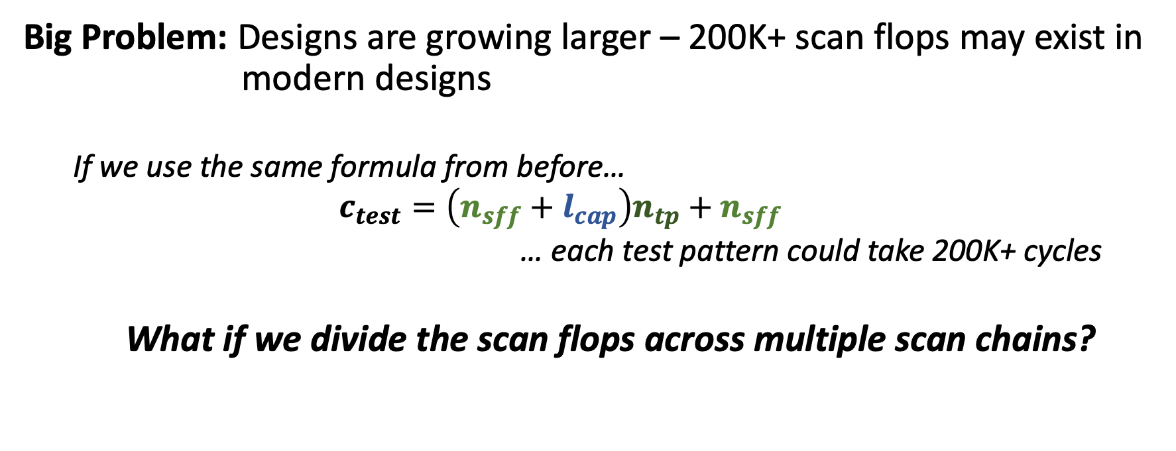
Test Compression Motivation
Big Problem: Designs are growing larger – 200K+ scan flops may exist in modern designs
  If we use the same formula from before…
  $$c_{test}=\left(n_{sff}+l_{cap}\right)n_{tp}+n_{sff}$$
  … each test pattern could take 200K+ cycles
  What if we divide the scan flops across multiple scan chains?

Slide 44
Single Scan Chain…
SCANIN
TC
COMB LOGIC
COMB LOGIC
COMB LOGIC
D
Q
COMB LOGIC
D
Q
D
Q
Primary Inputs
D
Q
D
Q
Primary Outputs
D
Q
D
Q
D
Q
D
Q
CLOCK
SCANOUT

Slide 45
…Becomes Three Scan Chains
SCANIN3
SCANIN2
SCANIN1
TC
COMB LOGIC
COMB LOGIC
COMB LOGIC
D
Q
COMB LOGIC
D
Q
D
Q
Primary Inputs
D
Q
D
Q
Primary Outputs
D
Q
D
Q
D
Q
D
Q
CLOCK
SCANOUT3
SCANOUT2
SCANOUT1
Parallelizes data input, reducing effective pattern length by 3X

Slide 46
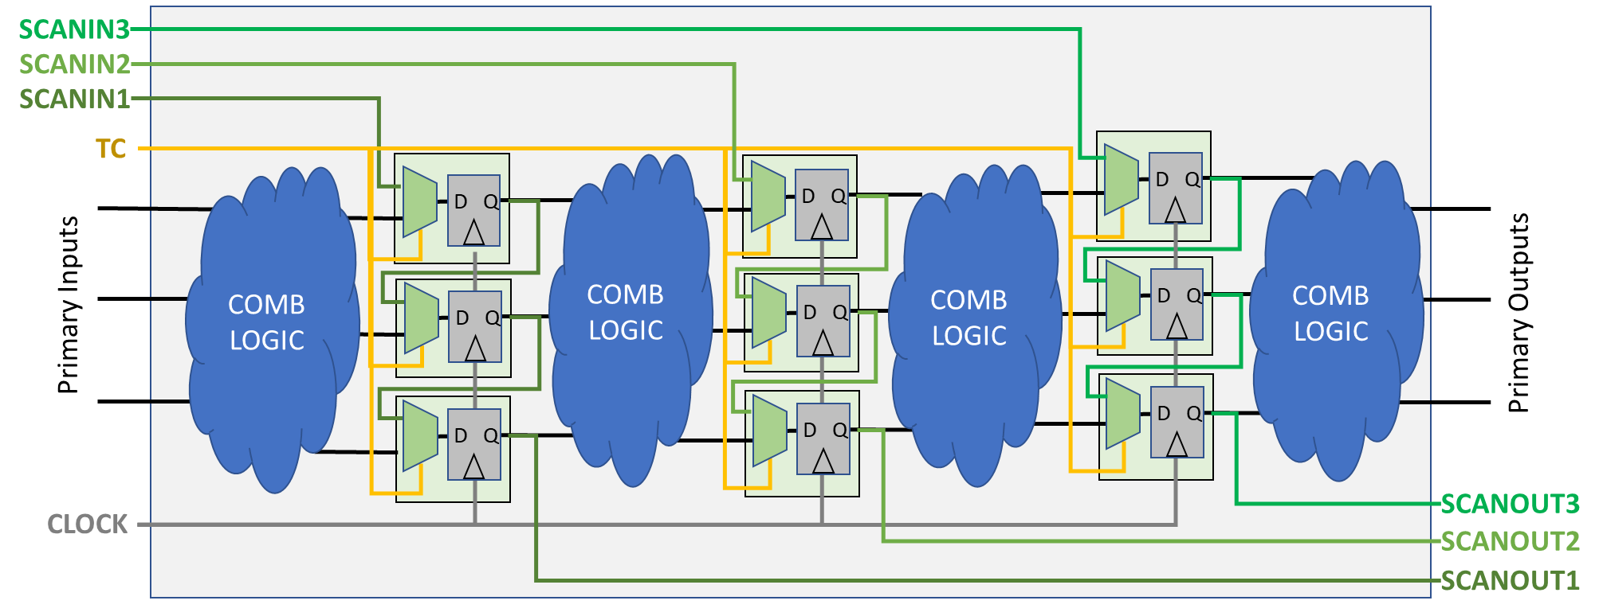
Test Compression Motivation
    *High number of tester channels can reduce potential multi-site testing (impacting overall throughput), increase probe-card complexity/cost…
  But, this brings another problem…
  Number of available primary input/output pins (also called tester channels) impact overall cost of test*
Reduces pattern length by 3X, but increases number of scanins/scanouts by 3X
  For input pins: what if we give up on controllability to save tester channels?
  For output pins: what if we give up on observability to save tester channels?
Key idea: How can we give up the least to get the most benefit?

Slide 47
Broadcast Scan-in Data to all Scan Chains
SCANIN1
TC
COMB LOGIC
COMB LOGIC
COMB LOGIC
D
Q
COMB LOGIC
D
Q
D
Q
Primary Inputs
D
Q
D
Q
Primary Outputs
D
Q
D
Q
D
Q
D
Q
CLOCK
SCANOUT3
SCANOUT2
SCANOUT1
Retains pattern length, reduces scan-in pins, but gives up on full controllability…

Slide 48
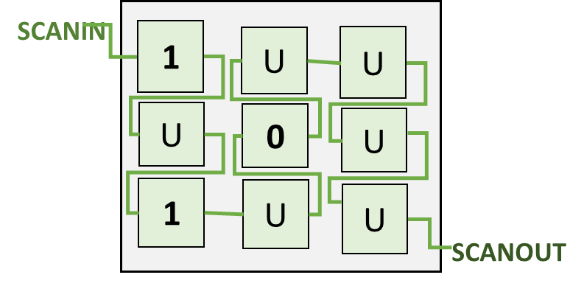
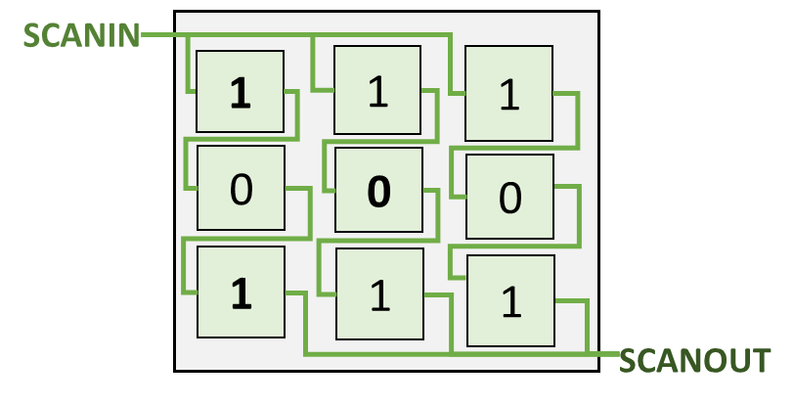
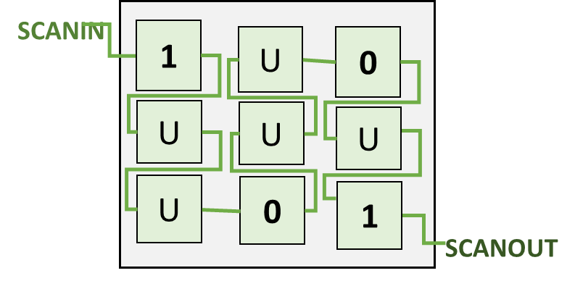

Why does Test Compression work?
Within a test cube, there may be unspecified input bits
These unspecified bits provide opportunity for leveraging to improve test cost
SCANIN
1
U
U
U
0
U
1
U
U
SCANOUT
Test Compaction
Merging test cubes to cover more faults in fewer patterns
Test Compression
Design techniques to increase test stimulus effect
Typically both are used in practice – ATPG must understand and work upon Test Compression Architecture

Slide 49
Broadcast-Scan-Based Techniques
Broadcasting of data from one input to multiple internal bits
Broadcast Scan [Lee 1998], [Lee 1999]
  Simple fanout of input data to multiple scan chains (or circuits)
010
01
0
0
0
0
1
1
1
0
0
0
0
0
0
1
1
1
0
0
0

Slide 50
Broadcast-Scan-Based Techniques
Illinois Scan [Hamzaoglu 1999], [Hsu 2001]
  Broadcast Mode: Simple fanout (similar to [Lee 1998])
  Serial Mode: Scan chains reconfigured to form one long scan chain, providing full controllability
Broadcast Mode
Serial Mode
Complementary modes can extract benefits of one technique, while using other modes to counter its weaknesses
Other advanced Broadcast-Scan techniques leverage reconfigurability and multiple scan inputs

Slide 51
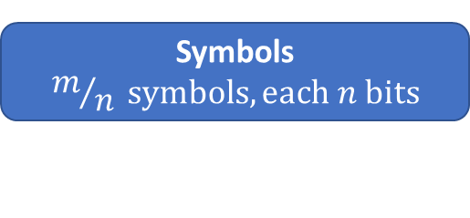
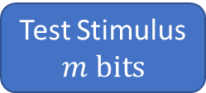
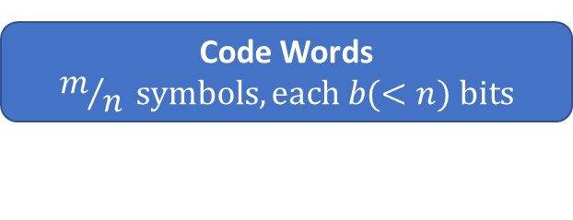
Code-Based Techniques
Use common data compression methods to encode test cubes
Dictionary Code Compression [Reddy 2002]
  Fixed-length code words fed into scan inputs used to represent test stimulus on internal scan chains
Test Stimulus
$$m bits$$
Divided into Symbols
Symbols
$$m/n symbols, each n bits$$
Symbols Encoded
Code Words
$$m/n symbols, each b(<n) bits$$
Cycle 1
Cycle 2
0
Cycle 3
1
Cycle 4
0
Dictionary
Dictionary
0
Dictionary
0
Dictionary
0
1
1
010
01
0
0
0
0
Input | Output
00 | 00010
01 | 01100
10 | 10010
11 | 00101
Input | Output
00 | 00010
01 | 01100
10 | 10010
11 | 00101
Input | Output
00 | 00010
01 | 01100
10 | 10010
11 | 00101
0
0
IN1
IN1
IN1
Input | Output
00 | 00010
01 | 01100
10 | 10010
11 | 00101
1
IN1
0
0
1
1
0
0
100
10
1
IN2
IN2
1
0
0
IN2
0
1
IN2
0
0
0
1
However, dictionaries can only store so many bits… they are typically not scalable to large and complex designs with many different needed input patterns
0

Slide 52
Code-Based Techniques
Run-Length Encoding [Jas 1998]
  Fixed-length b-bit codewords determine variable-length symbols defined by run-length of 0s
Symbol | Codeword
1 | 000
01 | 001
001 | 010
0001 | 011
00001 | 100
000001 | 101
0000001 | 110
0000000 | 111
Internal Scan Chain
Top-Level Scan In
00100010100000011000001
010 011 001 110 000 101
This can also be paired with other decompression architecture techniques to increase amount of “0”s in stimulus
2 “0”s
3
1
6
0
5
Other advanced Code-Based compression techniques deploy Huffman and Golomb encoding

Slide 53




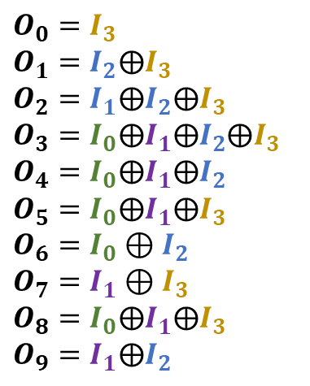











Linear Techniques
Utilizes XOR and Flip Flop logic to perform decompression of test cubes solvable through linear system of equations
Combinational Decompressors [Bayraktaroglu 2001]
  XOR network constructed with fanouts from scan in pins
$$I_{3}$$
$$I_{2}$$
$$I_{1}$$
$$I_{0}$$
$O_{0}=I_{3}$
$O_{1}=I_{2}⨁I_{3}$
$O_{2}=I_{1}⨁I_{2}⨁I_{3}$
$O_{3}=I_{0}⨁I_{1}⨁I_{2}⨁I_{3}$
$O_{4}=I_{0}⨁I_{1}⨁I_{2}$
$O_{5}=I_{0}⨁I_{1}⨁I_{3}$
$O_{6}=I_{0}⊕I_{2}$
$O_{7}=I_{1}⊕I_{3}$
$O_{8}=I_{0}⨁I_{1}⨁I_{3}$
$O_{9}=I_{1}⨁I_{2}$
XOR
System of Equations defined by XOR network and decompressor input-to-output relationship solved to determine input stimulus
XOR
XOR
XOR
XOR
XOR
XOR
XOR
XOR
XOR
XOR
XOR
XOR
XOR
$$O_{0}$$
$$O_{1}$$
$$O_{2}$$
$$O_{3}$$
$$O_{4}$$
$$O_{5}$$
$$O_{6}$$
$$O_{7}$$
$$O_{8}$$
$$O_{9}$$

Slide 54













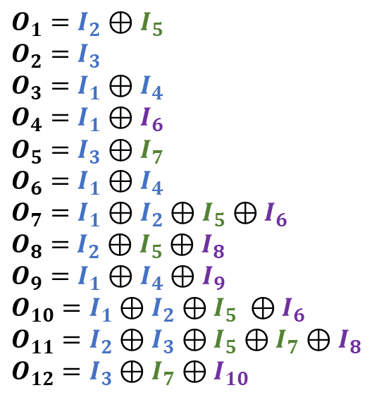









Linear Techniques
Sequential Decompressors
  Through incorporation of FFs, variables in the temporal dimension can also be brought into system of equations
Example: Linear Feedback Shift Register (LFSR) with Input Taps
$$I_{10}$$
$$I_{9}$$
$$I_{8}$$
$$I_{7}$$
$O_{1}=I_{2}⊕I_{5}$
$O_{2}=I_{3}$
$O_{3}=I_{1}⊕I_{4}$
$O_{4}=I_{1}⊕I_{6}$
$O_{5}=I_{3}⊕I_{7}$
$O_{6}=I_{1}⊕I_{4}$
$O_{7}=I_{1}⊕I_{2}⊕I_{5}$ $⊕I_{6}$
$O_{8}=$ $I_{2}⊕I_{5}⊕I_{8}$
$O_{9}=I_{1}⊕I_{4}⊕I_{9}$
$O_{10}=I_{1}⊕I_{2}⊕I_{5} ⊕I_{6}$
$O_{11}=I_{2}⊕I_{3}⊕I_{5}⊕I_{7}⊕I_{8}$
$O_{12}=I_{3}⊕I_{7}⊕I_{10}$
$$I_{6}$$
$$I_{5}$$
Complex System-of-Equations for test cube compression obtainable with just two input pins
$$I_{4}$$
$$I_{3}$$
$$I_{2}$$
$$I_{1}$$
$$O_{12}$$
$$O_{11}$$
$$O_{10}$$
$$O_{9}$$
$$O_{8}$$
$$O_{7}$$
$$O_{6}$$
$$O_{5}$$
$$O_{4}$$
$$O_{3}$$
$$O_{2}$$
$$O_{1}$$

Slide 55
Test Compression – Compaction
On the input side, we’re leveraging one bit (or a few bits) at the scan in pins to represent many bits within the scan chains
On the output side, we need many bits within scan chains to be represented by a single bit (or a few bits) at the output pins
If what we care about is observing fault effect, what logic can help us retain fault effect in observation?

Slide 56
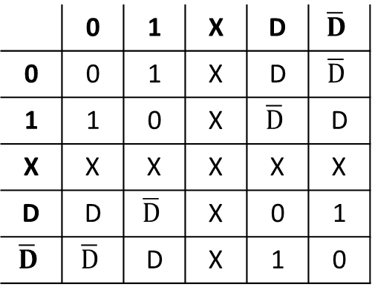
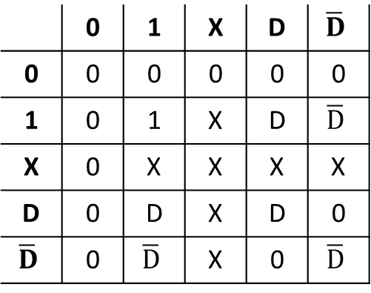
Test Compression – Transparent Gate
Transparent gate: change in input will always be transferred to a change in the output
Forward Implication Tables
AND Gate
XOR Gate
 | 0 | 1 | X | D | $$\overline{D}$$
0 | 0 | 0 | 0 | 0 | 0
1 | 0 | 1 | X | D | $$\overline{D}$$
X | 0 | X | X | X | X
D | 0 | D | X | D | 0
$$\overline{D}$$ | 0 | $$\overline{D}$$ | X | 0 | $$\overline{D}$$
 | 0 | 1 | X | D | $$\overline{D}$$
0 | 0 | 1 | X | D | $$\overline{D}$$
1 | 1 | 0 | X | $$\overline{D}$$ | D
X | X | X | X | X | X
D | D | $$\overline{D}$$ | X | 0 | 1
$$\overline{D}$$ | $$\overline{D}$$ | D | X | 1 | 0
Fault effect propagated when non-controlling value on other input…
… but blocked when controlling value on other input
For XOR gate, either value is non-controlling.
Single fault effect always propagated to output, no matter value on other input

Slide 57
XOR Compression as compactor
SCANIN3
SCANIN2
SCANIN1
TC
COMB LOGIC
COMB LOGIC
COMB LOGIC
D
Q
COMB LOGIC
D
Q
D
Q
Primary Inputs
D
Q
D
Q
Primary Outputs
D
Q
D
Q
D
Q
D
Q
CLOCK
XOR
XOR
SCANOUT1
Retains pattern length, reduces scan-in pins, but gives up on full observability…

Slide 58
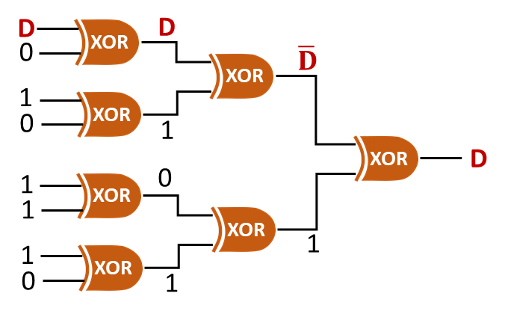
Test Compactor Techniques
Combinational (Space) Compaction
  Simple XOR Network can be deployed to combine output of many scan chains
Single fault effect on input to XOR Network compactor will be propagated to output.
Many internal chains compacted into one top-level signal.

Slide 59












Test Compactor Techniques
Sequential (Time) Compaction
  XOR gates and Flip Flops used to compact multiple inputs over multiple clock cycles
Example: Multiple-Input Signature Register (MISR)
$$O_{9}$$
$$O_{10}$$
$$O_{11}$$
$$O_{12}$$
$$O_{5}$$
$$O_{6}$$
$$O_{7}$$
$$O_{8}$$
Single fault effect on input to MISR Network compactor will be captured and retained until signature read-out
$$O_{1}$$
$$O_{2}$$
$$O_{3}$$
$$O_{4}$$

Slide 60
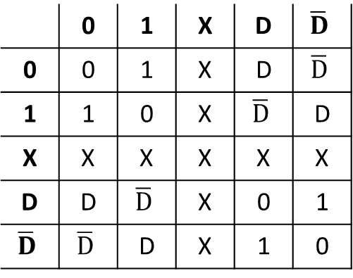

Challenges of Compression
Impact of “X”s in compactors
Let’s look again at the forward implication table of an XOR gate
XOR Gate
 | 0 | 1 | X | D | $$\overline{D}$$
0 | 0 | 1 | X | D | $$\overline{D}$$
1 | 1 | 0 | X | $$\overline{D}$$ | D
X | X | X | X | X | X
D | D | $$\overline{D}$$ | X | 0 | 1
$$\overline{D}$$ | $$\overline{D}$$ | D | X | 1 | 0
X
X
0
XOR
X
XOR
1
Any X on input to compactor overrides any fault detection on other inputs
D
XOR
$$\overline{D}$$
XOR
X
1
0
1
XOR
XOR
1
1
XOR
0
1
Xs on either input produce X at output
State-of-the-art industrial and research techniques are often focused around “X-tolerant” compactors
Xs corrupt fault detection!!!
Also significant effort in design/DFT on “cleaning” design to remove sources of Xs

Slide 61


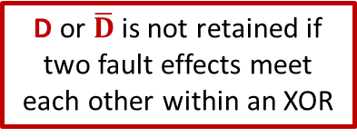
Challenges of Compression
Aliasing of Fault Effect
Again, the forward implication table of an XOR gate
XOR Gate
 | 0 | 1 | X | D | $$\overline{D}$$
0 | 0 | 1 | X | D | $$\overline{D}$$
1 | 1 | 0 | X | $$\overline{D}$$ | D
X | X | X | X | X | X
D | D | $$\overline{D}$$ | X | 0 | 1
$$\overline{D}$$ | $$\overline{D}$$ | D | X | 1 | 0
D
D
0
XOR
$$\overline{D}$$
XOR
1
0
XOR
1
D or $\overline{D}$ is not retained if two fault effects meet each other within an XOR
XOR
1
D
$$\overline{D}$$
1
XOR
XOR
D
1
XOR
0
1
If two faults come together in an XOR compressor, they can cancel each other out and prevent detection
Consideration required in scan chain stitching, compactor construction, test pattern generation to avoid such cases

Slide 62
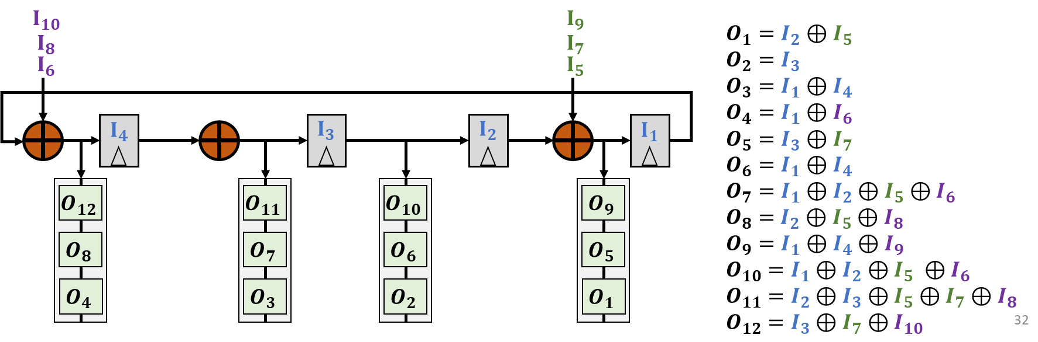

Challenges of Compression
Debug and Diagnosis of Failures
Output – Compactor
Input – Decompressor
D
D
0
XOR
$$\overline{D}$$
All we see is the D at the failing output…
XOR
1
0
XOR
1
XOR
D
1
0
1
XOR
XOR
1
Which of compactor inputs (scan chains) is failing?
1
XOR
SoE needs solving for all desired test stimulus
0
1
Observation of the fault effect is great for achieving coverage, but gives little information to locate failures for debug purposes. Diagnosis techniques for failing flop identification may report in terms of confidence
If custom internal stimulus is desired, SAT solver analysis from ATPG tools is likely needed. Further, some of these custom test cubes might not be deployable in certain decompression architectures
Industrial solutions often also include other modes for improved controllability/observability in debug
(Much like serial mode in Illinois Scan Architecture)

